Slide 1
Platelets
By
Dr. Hussein AlNaji

Slide 2
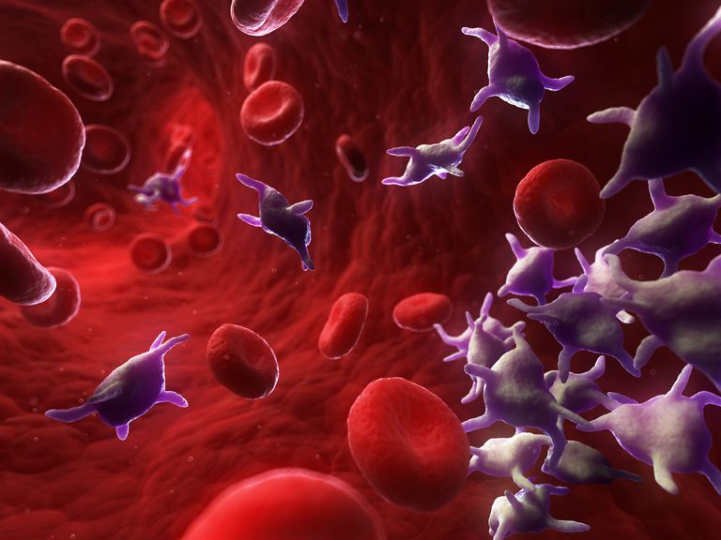
Platelets, also called thrombocytes (from Greek "clot" and "cell"), are a component of blood whose function (along with the coagulation factors) is to react to bleeding from blood vessel injury by clumping, thereby initiating a blood clot. Platelets have no cell nucleus: they are fragments of cytoplasm that are derived from the megakaryocytes of the bone marrow, and then enter the circulation.

Slide 3
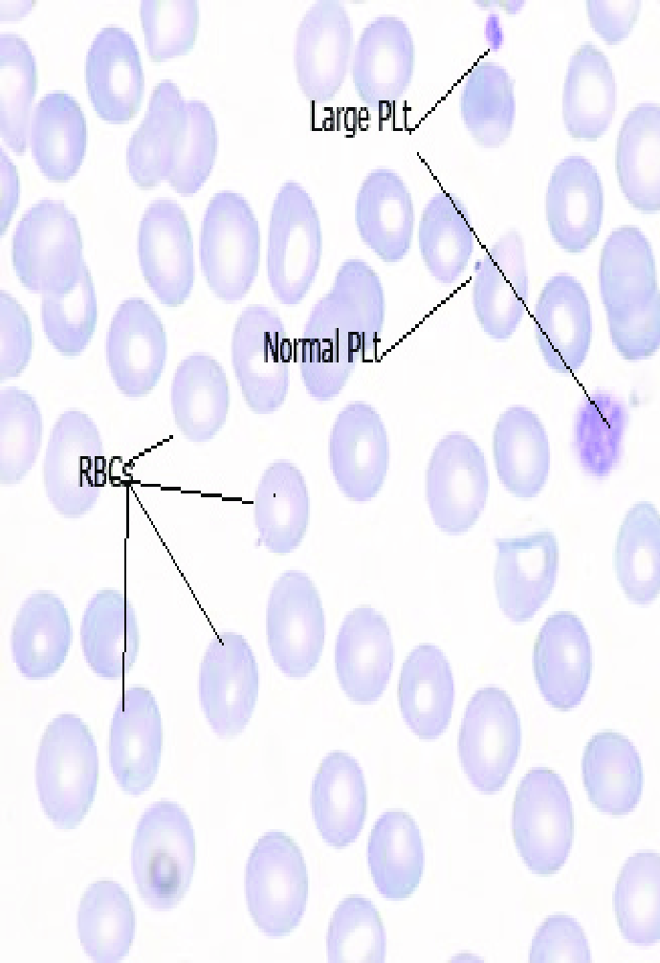
Platelets appearance
On a stained blood smear, platelets appear as dark purple spots, about 20% the diameter of red blood cells. The smear is used to examine platelets for size, shape, qualitative number, and clumping. The ratio of platelets to red blood cells in a healthy adult ranges from 1:10 to 1:20.
Avian and reptilian platelets are much larger than mammalian platelets, though still smaller than the red blood cells, and they are true cells with nuclei.

Slide 4
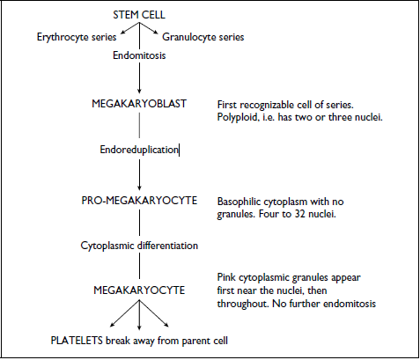
Platelet production
Like erythropoiesis, this occurs in bone marrow from stem cell differentiation to platelets production take about 3 a days.

Slide 5
Platelet function
Normal running maintenance of the endothelium.
Repair of damaged endothelium via some ways.
An injury to the endothelium exposes underlying collagen and a single layer of platelets sticks to this (platelets don’t normally stick to intact blood vessels).
Upon exposure of platelets to the collagen fibers of the vessel wall, serotonin, histamine and ADP (adenosine diphosphate) lare released in to the ambient fluid (platelets released). The ADP causes adherence of the second of platelets layer to the first and aggregation of a platelets plug.
The plug retracts ( viscous metamorphosis) to form a mechanically strong patch which seals the hole. In time this is replaced by normal endothelium.

Slide 6
Thrombocytosis
Increase in platelets number.
Splenic contraction results in increased blood platelet counts.
Splenec­tomy can also result in a thrombocytosis, which can last for several months.
Thrombocytosis is seen in association with various inflammatory and neoplastic conditions in animals.
Thrombocytosis may also occur in association with acute anemia, Recombinant erythropoietin induces thrombocy­tosis in cats, dogs, and humans.
Reactive. In hemorrhagic cases the consumption of platelets soon leads to an increase in circulating numbers via feedback effect.

Slide 7
Thrombocytopenia
Decrease in platelet numbers
Functional, in early stages of a haemorrhagic condation when demand is great but bone marrow production has not yet responded.
Thrombotic/thrombocytopenic purpura, Disseminated Intravascular coagulation (DIC) or consumption coagulopathy.
Autoimmune.
Primary bone marrow suppression. Such as bracken poisoning., drug sensitivity.
Lymphosarcoma.
Equine infectious anemia.

